Slide 1



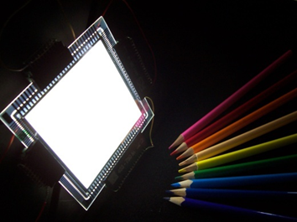

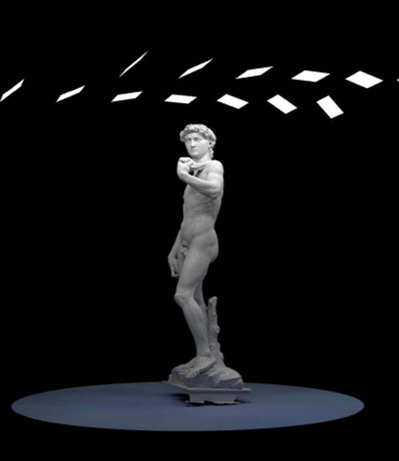
Novaled
Novaled
Development of innovative white OLEDs for high quality lighting in art exhibitions
project PON04a3_00369

Slide 2
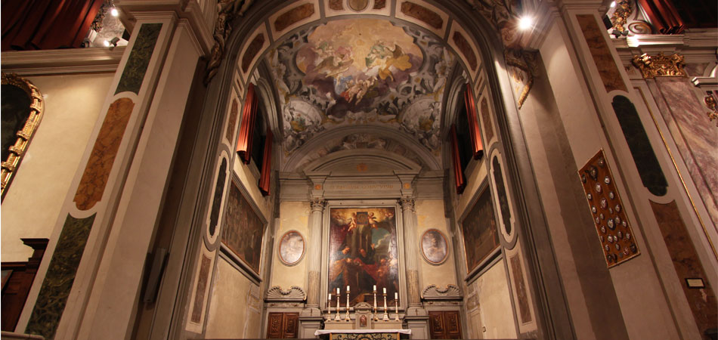
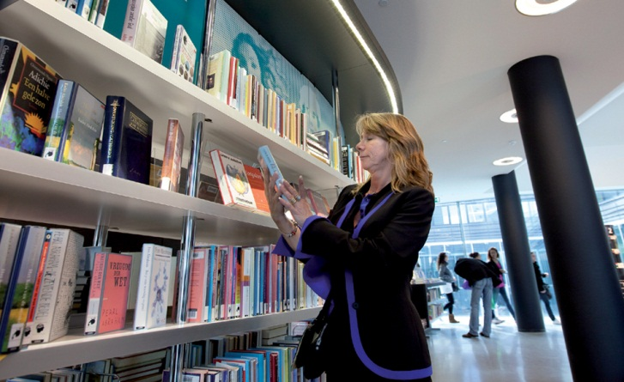
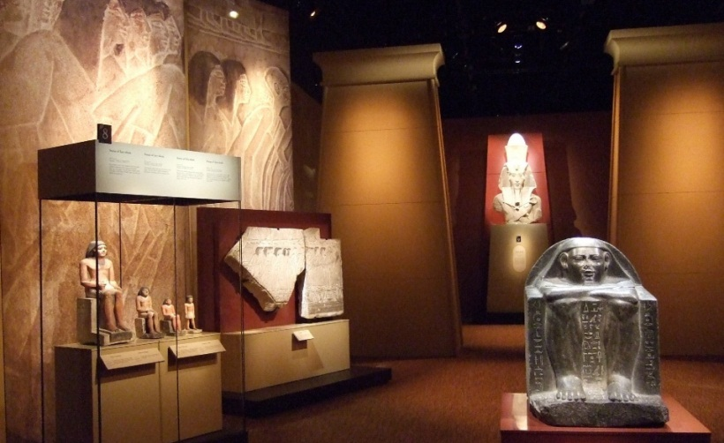
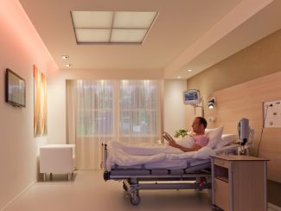
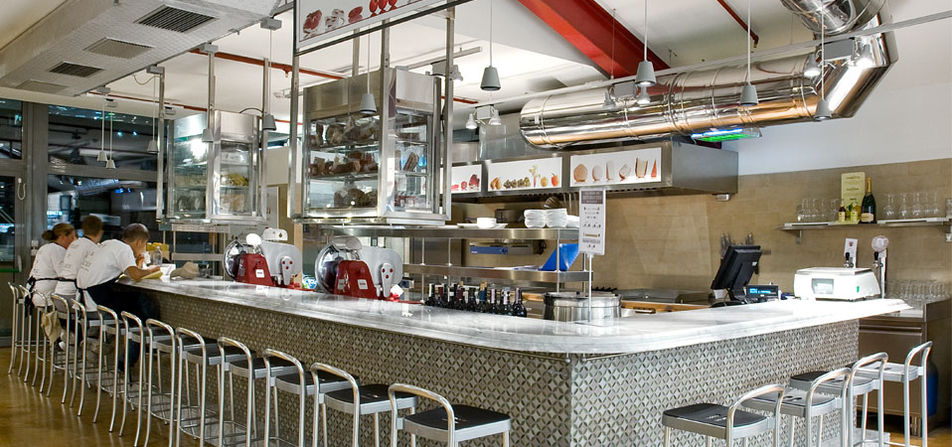
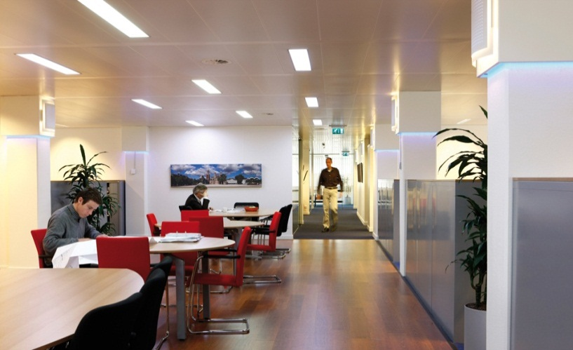
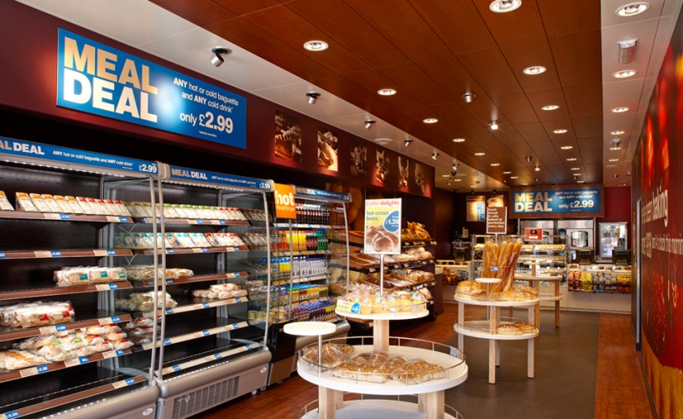
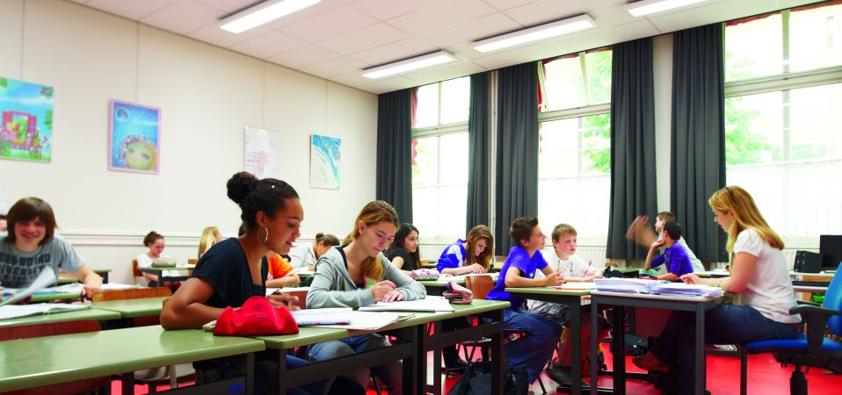
High quality lighting applications
Source: PHILIPS

Slide 3
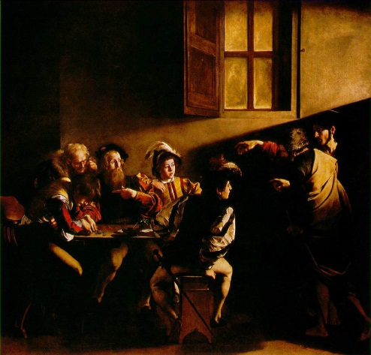
Key features of high quality lighting
High CRI (Color Rendering Index)
No emission in UV and IR
Good color
Good light comfort
High efficiency
Beautiful design of the lamp
Source type | High CRI | No UV and IR | Good color | Light comfort | High efficiency | Beautiful design
Halogen | √ | specific | √ | x | x | x
Fluorescent tube | specific | √ | specific | x | √ | x
LED | specific | √ | specific | x | √ | x

Slide 4
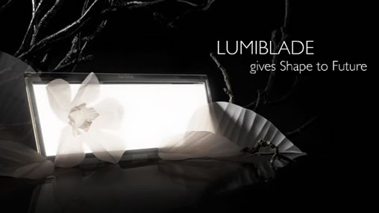
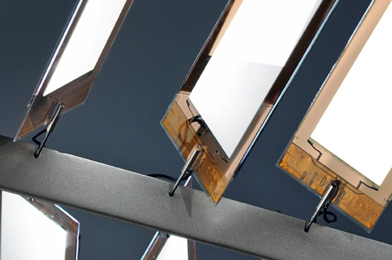
OLEDs for lighting
FINAL GOAL:
REPLACEMENT OF STANDARD LIGHT SOURCES FOR IN-DOOR LIGHTING
LUMIBLADE by PHILIPS
ADVANTAGES:
New architecture possibilities
Large areas, ultra-thin thicknesses
High quality lighting
Good visive comfort
Early Future
by Ingo Maurer/OSRAM

Slide 5
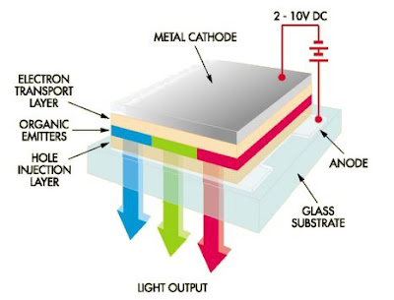
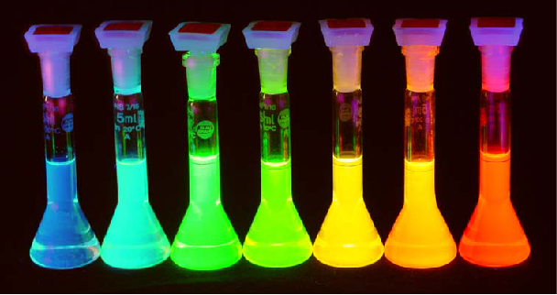
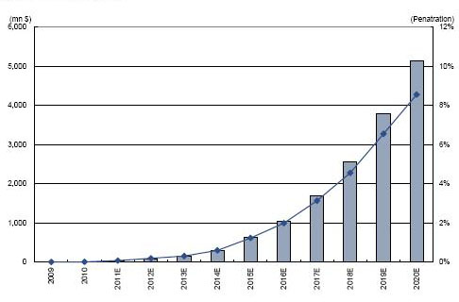
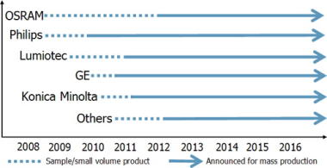
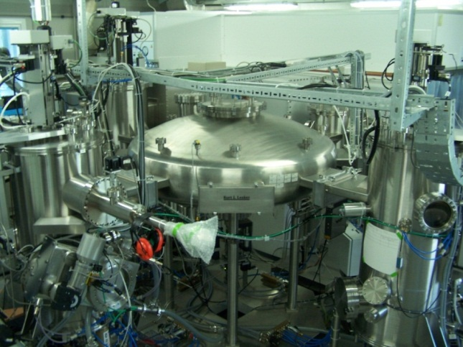
OLED structure
Organic emitters in solution
The world of OLEDs
Market trends for OLEDs (Display Search)
Cluster Tool machine in Lecce

Slide 6
Focus on the problems
Low efficiencies compared to fluorescent tubes
Not easy to fabricate on flexible substrates
High costs
Why?
ANODE MATERIAL:
BRITTLE AND EXPENSIVE

Slide 7
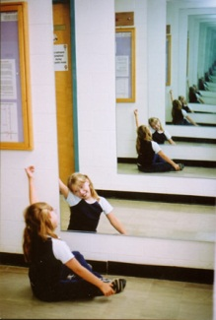
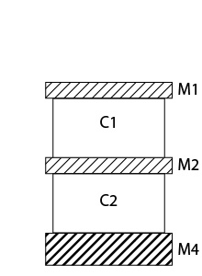
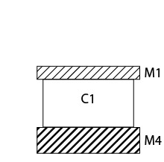
The IDEA: multiple microcavity OLEDs
Anode material substitution with a metal mirror→ metallic microcavity
1 Microcavity=amplified emission in the resonance wavelength=monochromatic light
Multiple microcavities=different resonance wavelengths=white light

Slide 8
Project objectives
Development of OLED prototypes with the following features:
Efficiency of 60 lm/W
90 CRI
Standard lighting color
Large area (5x5 cm)
Flexible substrates
Source type | High CRI | No UV e IR | Good color | Visive comfort | High efficiency | Beautiful design
OLED | √ | √ | √ | √ | √ | √

Slide 9
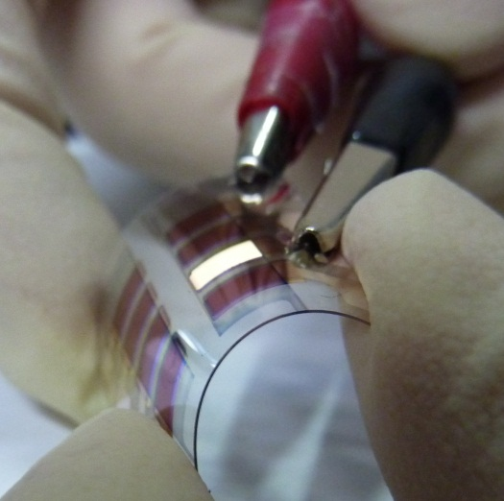
What is already done
Current multicavity OLED prototypes have the following features:
Efficiency of 35 lm/W
85 CRI
Warm white color
Small area
Best efficiency on flexible substrates ever reported: 15 lm/W
Research challenges:
Efficiency improvement
CRI improvement
Active area scale up

Slide 10

Collaborations & contacts
COLLABORATIONS:
CNR-NANO Lecce, Nanotechnology Research Center
CONTACTS:
Armando Genco: g.rnd@libero.it
Twitter: #evOled_ITA

